Slide 1
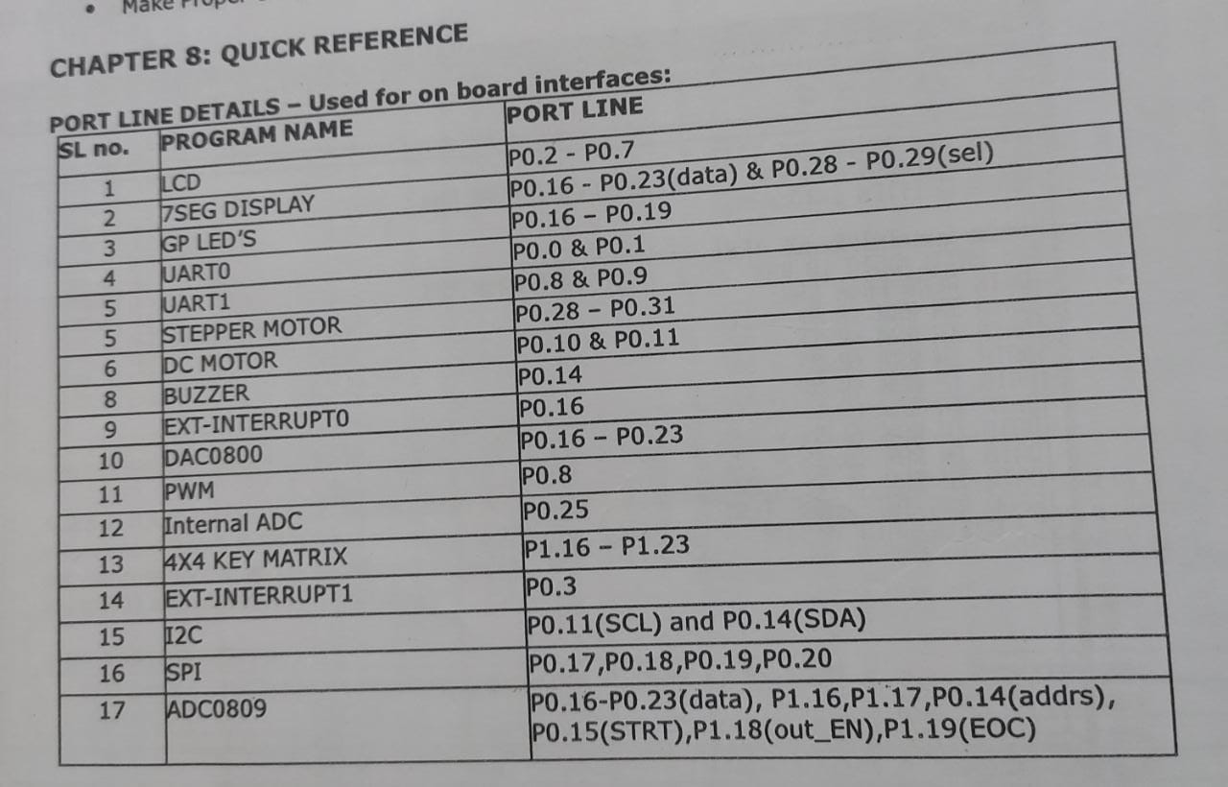

Slide 2
Flashing LED’s:
Light Emitting Diodes (LED’s) are components most commonly used for displaying the port line status.
There are 4 LEDs on the board;
these lines are connected to the Port lines P0.16 (PB0) to P0.19 (PB3) through buffer.
P0.16 | P0.17 | P0.18 | P0.19
PB0 | PB1 | PB2 | PB3
Signal | LED State
0 | ON
1 | OFF

Slide 3
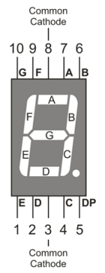
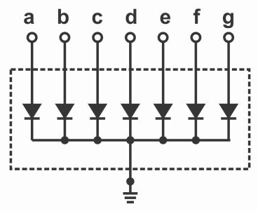
Seven Segment Display:
There are 2 Seven segment (Common Cathode) display on the board;
Segment select lines are connected to P0.28 and P0.29.
These lines are connected to the Port lines P0.16 to P0.23.
Dec | P0.23 | P0.22 | P0.21 | P0.20 | P0.19 | P0.18 | P0.17 | P0.16 | Hex
 | DP | G | F | E | D | C | B | A
0 | 0 | 0 | 1 | 1 | 1 | 1 | 1 | 1 | 3f
1 | 0 | 0 | 0 | 0 | 0 | 1 | 1 | 0 | 06
2 | 0 | 1 | 0 | 1 | 1 | 0 | 1 | 1 | 5b
3 | 0 | 1 | 0 | 0 | 1 | 1 | 1 | 1 | 4f
4 | 0 | 1 | 1 | 0 | 0 | 1 | 1 | 0 | 66
5 | 0 | 1 | 1 | 0 | 1 | 1 | 0 | 1 | 6d
6 | 0 | 1 | 1 | 1 | 1 | 1 | 0 | 1 | 7d
7 | 0 | 0 | 0 | 0 | 0 | 1 | 1 | 1 | 07
8 | 0 | 1 | 1 | 1 | 1 | 1 | 1 | 1 | 7f
9 | 0 | 1 | 1 | 0 | 1 | 1 | 1 | 1 | 6f
A | 0 | 1 | 1 | 1 | 0 | 1 | 1 | 1 | 77
b | 0 | 1 | 1 | 1 | 1 | 1 | 0 | 0 | 7c
C | 0 | 0 | 1 | 1 | 1 | 0 | 0 | 1 | 39
d | 0 | 1 | 0 | 1 | 1 | 1 | 1 | 0 | 5e
E | 0 | 1 | 1 | 1 | 1 | 0 | 0 | 1 | 79
F | 0 | 1 | 1 | 1 | 0 | 0 | 0 | 1 | 71
P0.28 | P0.29
Segment Select 1 | Segment Select 2

Slide 4
DC Motor:
The two terminals of DC Motor are connected to the Port lines P0.10 & P0.11
P0.11 | P0.10 | DC Motor state
1 | 1 | Anti-Clockwise
0 | 1 | Clockwise
0 | 0 | Stop

Slide 5
Buzzer:
Buzzer is connected to the Port line P0.14
P0.14 | Buzzer state
0 | OFF
1 | ON

Slide 6
Stepper Motor:
The Stepper motor can be interfaced to the board by connecting it into the Power Mate PM1.
The rotating direction of the stepper motor can be changed through software.
Port lines used for Stepper motor are P0.28 to P0.31.
P0.31 | P0.30 | P0.29 | P0.28 | Hex
A | B | C | D
0 | 0 | 0 | 1 | 01
0 | 0 | 1 | 0 | 02
0 | 1 | 0 | 0 | 04
1 | 0 | 0 | 0 | 08

Slide 7
Switch:
Switches are input components.
There are 4 DIP Switches on the board;
these lines are connected to the Port lines P1.20 to P1.23.
Switch state | Signal
Up | ON
Down | OFF
P1.20 | P1.21 | P1.22 | P1.23
SW0 | SW1 | SW2 | SW3

Slide 8
Keypad (4 Rows X 4 Columns):
The switches SW4 to SW19 are organized as 4 rows X 4 columns matrix.
One end of all the switches are connected to port lines
P1.20 – P1.23, which is configured as rows.
The other end of the matrix is connected to the port lines
P1.16 – P1.19, which is configured as columns.
Dec | P1.23 | P1.22 | P1.21 | P1.20 | P1.19 | P1.18 | P1.17 | P.16 | Hex
 | R3 | R2 | R1 | R0 | C3 | C2 | C1 | C0
0 | 1 | 1 | 1 | 0 | 1 | 1 | 1 | 0 | EE
1 | 1 | 1 | 1 | 0 | 1 | 1 | 0 | 1 | ED
2 | 1 | 1 | 1 | 0 | 1 | 0 | 1 | 1 | EB
3 | 1 | 1 | 1 | 0 | 0 | 1 | 1 | 1 | E7
4 | 1 | 1 | 0 | 1 | 1 | 1 | 1 | 0 | DE
5 | 1 | 1 | 0 | 1 | 1 | 1 | 0 | 1 | DD
6 | 1 | 1 | 0 | 1 | 1 | 0 | 1 | 1 | DB
7 | 1 | 1 | 0 | 1 | 0 | 1 | 1 | 1 | D7
8 | 1 | 0 | 1 | 1 | 1 | 1 | 1 | 0 | BE
9 | 1 | 0 | 1 | 1 | 1 | 1 | 0 | 1 | BD
A | 1 | 0 | 1 | 1 | 1 | 0 | 1 | 1 | BB
b | 1 | 0 | 1 | 1 | 0 | 1 | 1 | 1 | B7
C | 0 | 1 | 1 | 1 | 1 | 1 | 1 | 0 | 7E
d | 0 | 1 | 1 | 1 | 1 | 1 | 0 | 1 | 7D
E | 0 | 1 | 1 | 1 | 1 | 0 | 1 | 1 | 7B
F | 0 | 1 | 1 | 1 | 0 | 1 | 1 | 1 | 77
P1.19 | P1.17 | P1.18 | P1.19
C0 | C1 | C2 | C3
R0 | P1.20
R1 | P1.21
R2 | P1.22
R3 | P1.23

Slide 9
16X2 LCD Interface :
A 16X2 Alphanumeric LCD Display with back light is provided along with the Evaluation Board.
The LCD is interfaced using 4 – bit mode.
RS = 0 for sending Command to the LCD, controlled by port P0.2
RS = 1 for sending Data to the LCD, controlled by port P0.2
R/W = 1 for reading from the LCD
R/W = 0 for writing to the LCD, normally it is grounded
EN = 0 for disabling the LCD
EN = 1 for enabling the LCD, controlled by port P0.3
D4 to D7 (P0.4 to P0.7) – data lines

Slide 10
PORT LINE DETAILS – Used for on board interfaces:
SL no. PROGRAM NAME PORT LINE
1 LCD P0.2 - P0.7
2 GP LED’S P0.16 – P0.19
3 UART0 P0.0 & P0.1
4 UART1 P0.8 & P0.9
5 STEPPER MOTOR P0.28 – P0.31
6 EXT-INTERRUPT0 P0.16
7 DAC0800 P0.16 – P0.23
8 PWM P0.8
9 Internal ADC P0.25
10 4X4 KEY MATRIX P1.16 – P1.23
11 EXT-INTERRUPT1 P0.3
12 I2C P0.11(SCL) and P0.14(SDA)
13 SPI P0.17,P0.18,P0.19,P0.20
14 ADC0809 P0.16-P0.23(data), P1.16,P1.17,P0.14(addrs),
P0.15(STRT),P1.18(out_EN),P1.19(EOC)

